Slide 1

Laura Howard
Interim Secretary, Kansas Department for Children and Families
House Social Services Budget Committee
Agency Overview and Budget Summary
January 24, 2019
Dan Lewien, Chief Financial Officer
Rebekah Gaston, Policy Director

Slide 2


Chairman Carpenter, Vice Chair Mastroni, Ranking Member Ballard and members of the Committee:
Thank you for the opportunity to provide testimony on the Kansas Department for Children and Families (DCF). I assumed the role of Interim Secretary of DCF and of KDADS on January 14, 2019.
An overview of DCF programs and the Governor’s Budget for the Agency follows. We will provide more details and information on the budget as we work through the process.

Slide 3



OUR MISSION
Protect Children
Promote Healthy Families
Encourage Personal Responsibility

Slide 4




OUR MAJOR PROGRAM AREAS
Economic and Employment Services
Prevention and Protection Services
Rehabilitation Services
Child Support Services

Slide 5

Economic and Employment Services
Economic and Employment Services (EES) provides a variety of programs that can help families achieve self-reliance. These include:
  cash assistance (Temporary Assistance for Needy Families)
  food assistance (Supplemental Nutrition Assistance Program)
  child care assistance
  employment assistance
  energy assistance
Kansas Benefits Card Support
1-800-831-5235

Slide 6
Prevention and Protection Services
Prevention and Protection Services helps families and vulnerable adults by providing:
  protection services (PRC and investigations)
  family-based assessments
  family support services
  family preservation
  foster care
  adoption services
  independent living services for older youth
Kansas Protection Report Center
1-800-922-5330

Slide 7
Rehabilitation Services
Rehabilitation Services offers a variety of programs to meet the diverse needs of Kansans with disabilities, including:
  vocational services
  independent living
  services for older Kansans who are blind or visually impaired
  disability determination services on behalf of the Social Security Administration
  end dependence grants
Rehabilitation Customer Service Center
1-866-213-9079

Slide 8
Child Support Services
Child Support Services helps children receive the financial support necessary for their growth and development. The program assists by:
  establishing parentage and orders for child support
  locating non-custodial parents and their property
  enforcing child support orders
  modifying support orders, as needed
Child Support Service Center
1-888-757-2445

Slide 9
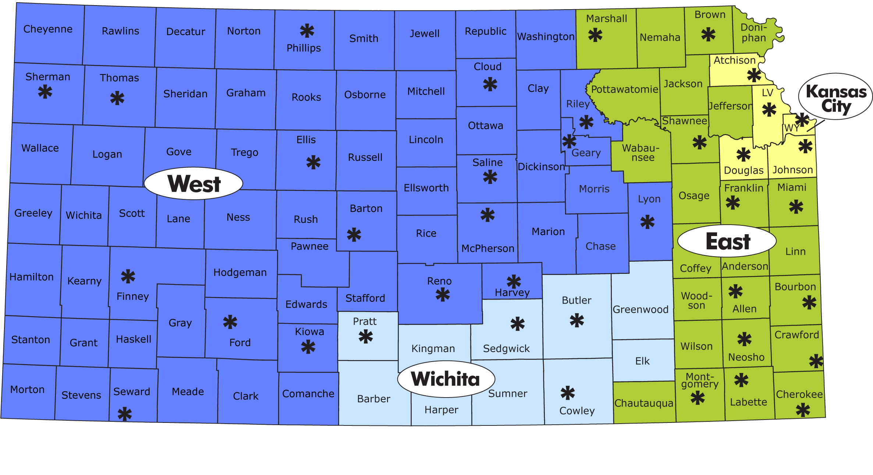
DCF Regional Map 4 Regions, 36 Service Centers
East Region – Topeka: 785-296-1491 Kansas City Region – KC: 1-800-766-3777
West Region – Manhattan: 1-800-766-3777 Wichita Region – Wichita: 316-337-6789

Slide 10

FY 2019 Agency Budget
$685 million budget
2,592 positions
Funding sources:
  Federal: $364.0 million
  SGF: $295.9
  other state funds: $24.6
    (Fee Funds, Children’s Initiative Funds)
    SNAP Assistance is not included in the total because it is an off-budget item.

Slide 11
FY 2020 Agency Budget
$743 million budget
2,618 positions
Funding sources:
  Federal: $384.8 million
  SGF: $332.2
  other state funds: $25.8

Slide 12
Additions to the Approved SGF
The Governor’s budget added $2.8 million SGF in FY 2019 and $13.2 million SGF for FY 2020 in addition to the approved SGF in the base budget. These FY 2019 Supplementals and FY 2020 Enhancements are targeted primarily to improve the child welfare system and coordination of support.
In addition, The Fall 2018 Consensus Caseload added $3.7 million SGF in FY 2019 and $36.7 million SGF in FY 2020 to the Foster Care program

Slide 13
Governor’s Supplementals & Enhancements
Add Additional Child Welfare Positions
  Positions will be added throughout the state to improve timeliness in the PRC, reduce caseloads for child investigation staff, and reduce caseloads for foster care and adoption workers.
  FY 2019: 26 positions, $831,052 AF, $802,296 SGF
  FY 2020: 26 additional positions to total 52, $3,287,008 AF, $3,173,276 SGF
Family Preservation Expansion
  Additional Children’s Initiative Funds (CIF) were added to the Family Preservation program to serve additional families that are at risk of having a child removed from the home. This increases the current program from $10.8 million AF to $12 million
  FY 2020 only: $1,086,705 CIF

Slide 14
Governor’s Supplementals & Enhancements
Family First Prevention Services Act (FFPSA)
  New federal law allows states to use Title IV-E federal matching funds to provide prevention services to children at risk of entering state custody. Programs must be evidence based and in the Clearing House. States must restructure residential placements.
  Evidence based prevention programs, $8.8m AF FY20
  Children at substance abuse treatment, $36k FY19, $73k FY20
  3 Staff, background checks & licensing, $502k FY19, $452k FY20
  Total FY 2019: $537,518 All Funds, $452,516 SGF
  Total FY 2020: $9,296,216 All Funds, $6,928,295 SGF

Slide 15
Governor’s Supplementals & Enhancements
Continued
Kansas Eligibility Enforcement System (KEES) Enhancements
  Funding was added to provide needed improvements to the system that determines eligibility for multiple state programs.
  FY 2019: $3,675,605 All Funds, $1,581,613 SGF
  FY 2020: $7,097,024 All Funds, $3,053,849 SGF
Total Supplementals and Enhancements:
FY 2019 $5,044,175 All Funds, $2,836,425 SGF
FY 2020 $20,766,953 All Funds, $13,155,420 SGF

Slide 16
FY 2020 DCF AF Expenditures by Program (millions)
Total budget = $742.9 million

Slide 17
FY 2020 DCF SGF by Program (millions)
Total SGF = $332.2 million

Slide 18
FY 2020 DCF All Funds Expense by Type (millions)
Salaries
Regions | $93.3
Administration | $8.5
Prevention and Protection | $7.6
Economic and Employment | $7.4
Information Technology | $7.4
Rehabilitation Services | $6.9
Child Support Services | $2.2
Licensing | $2.1
Other | $0.7
Total | $136.0
Assistance
Prevention and Protection | $308.9
Economic and Employment | $143.9
Rehabilitation Services | $19.2
Child Support Services | $1.5
Other | $0.4
Total | $473.9
OOE
Child Support Services | $32.8
Information Technology | $25.1
Regions | $19.5
Administration | $13.2
Rehabilitation Services | $11.2
Economic and Employment | $9.2
Prevention and Protection | $4.9
Licensing | $0.2
Other | $0.9
Total | $117.2

Slide 19
DCF Funding Sources FY 2020 (millions)

Slide 20
FY 2020 DCF Federal Funds (millions)
* Expenditures exclude $284.7 million in off-budget SNAP Assistance
Other Funds include IV-B, Chafee, and several smaller funds

Slide 21
DCF Caseload Summary
 |  | FY 2018 | FY 2019 | FY 2020 | FY 2021
Program |  | Actual | GBR | GBR | GBR
Economic and Employment Services
TANF Cash Assistance | Average monthly persons | 9,605 | 8,916 | 8,477 | 8,112 | [1]
 | Assistance | $13,143,547 | $12,200,000 | $11,600,000 | $11,100,000
TANF Employment Services | Average monthly adults | 2,818 | 2,459 | 2,459 | 2,459
 | Assistance | $2,830,472 | $2,556,004 | $2,645,903 | $2,738,963
SNAP (Food Assistance) | Average monthly persons | 219,738 | 210,435 | 206,141 | 201,846 | [2]
 | Assistance | $299,351,743 | $289,137,937 | $284,721,375 | $280,485,186
SNAP Employment and Training | Average monthly adults | 785 | 4,762 | 4,155 | 4,140 | [3]
 | Assistance | $841,880 | $4,580,566 | $3,862,710 | $3,848,267
Child Care Assistance | Average monthly children | 9,263 | 9,999 | 11,896 | 11,363
 | Assistance | $38,373,468 | $46,578,872 | $61,959,404 | $60,930,229
Kansas Early Head Start | Children | 936 | 954 | 954 | 954
 | Assistance | $9,238,642 | $10,531,268 | $10,531,268 | $10,531,268

Slide 22
DCF Caseload Summary (continued)

Slide 23
DCF Caseload Summary (continued)

Slide 24

Foster Care Caseload

Slide 25
TANF Caseload

Slide 26
Key Issues Going Forward
Child Welfare Grants
Families First Prevention Services Act
Child Welfare Task Force and Mental Health Task Force
Safety Net Programs
Collaboration and Cross-Agency Coordination
Questions?

